Slide 1
Vestas
Capstone Project
V100's 17th Harmonic

Slide 2

What is Vestas?
http://video.vestas.com/

Slide 3
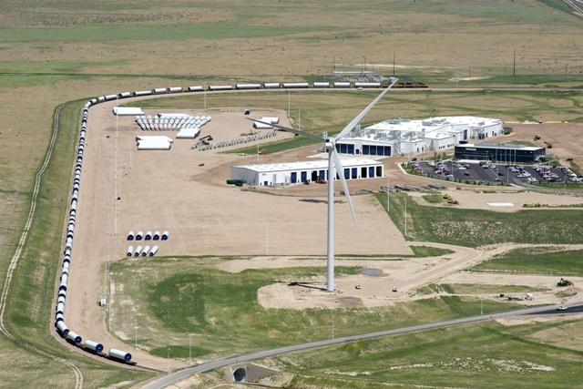
What platform are we focused on?
Our Vestas/PSU capstone group is focused on the 2.0MW Platform
We will primarily be looking at the V100
Our Prototype at our Tower factory in Colorado - measurements taken show elevated levels of the 17th and 19th Harmonic.

Slide 4
What's the Problem?
The Vestas V100 turbine in Colorado is next to a tower factory- the tower factory may cause a disturbance on the grid. This disturbance may cause a current spike at the 17th and 19th Harmonic.
We do not know the impact of this issue on other sites but we suspect it may be an issue.

Slide 5
How many turbines could this affect?
We have 2.0GW of the 2.0MW platform in North America
Harvest II Wind Farm has 33 turbines and loses 1500 MWh of production annually to the grid disturbances. Cause unkown
Back of the envelope calculations
($80/MWh) x 1500 MWh = $120,000 lost at Harvest II wind farm.

Slide 6
What happens when the turbine experiences a grid disturbance?
The turbine has a breaker called the Q8 breaker that trips when it experiences a current spike.
Sometimes these breakers can be reset automatically or remotely.
In the case that the breaker must be manually reset - the owner or service provider must send a technician to reset.

Slide 7
How do we know the breaker has tripped?
SCADA supervisory control and data acquisition
Every time the breaker trips it sets an alarm off that is recorded in a database.
The alarm alerts a surveillance team to correct the alarm
The data can be mined to find trends.

Slide 8
How do we get started?
My assumptions ( need to be verified by Craig)
We mine the Q8 breaker data to find trends across North America. We filter by V100 turbines, with a focus on the prototype turbine in Colorado and the Harvest II site in Michigan- we compare those alarms with the remaining V100 fleet to see if it's an isolated issues.
(Who can help us? Vestas Data Analyst - Mike Lang?)

Slide 9
Getting started (Slide 2)
We build a model of the V100 turbine from an impedance standpoint in SPICE.
We evaluate other software applications available to model the turbine and test assumptions
How can we best show the problem in a model?

Slide 10
What are trying to find/show?
Where is the 17th harmonic coming from? The grid? The turbine?
How many Vestas turbines in North America are affected by this?
Can you mitigate this harmonic?
What does it take to mitigate this harmonic?
What does it cost to mitigate it?

Slide 11
Must / should / nice to have
Must
Find the source of the harmonic
Build an impedance model
Find a way to mitigate it
Should
Design a solution (filter) in a model
Find cost to the solution
Nice to have
Build the solution
Create a proposal to sell the solution
Sell the solution to a customer

Slide 12
Questions for Vestas Engineers
(Write Questions here)

